Slide 1
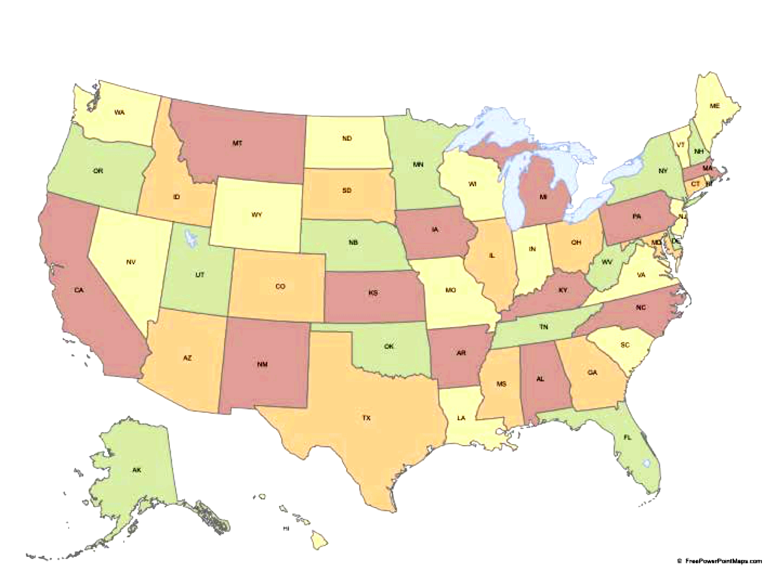
Active LENR Research in North America Presented to the Stanford Energy Club – 1/25/2017
Clean Planet
Clean Planet
Lakehead U.
B. Ahern
MIT
D. Szumski
Quantum Potential
Nanortech
LENR Invest
Brillouin
Widon & Larsen
Spectal Research
U. Of Illinois
G. W. U.
Coolescence
SRI
Passell
Howard U.
MFMP
SKINR
Industrial Heat
Ed Storms
Tom Claytor
U of La Verne
ReResearch
Texas Tech
Science for Humanity
Dennis Cravens
Global Energy Corp
Anonymous
U. of Texas
Dennis Letts
1st Gate
Research
Funding
Anonymous
Commercial
Legal
Mechanism
1

